Slide 1
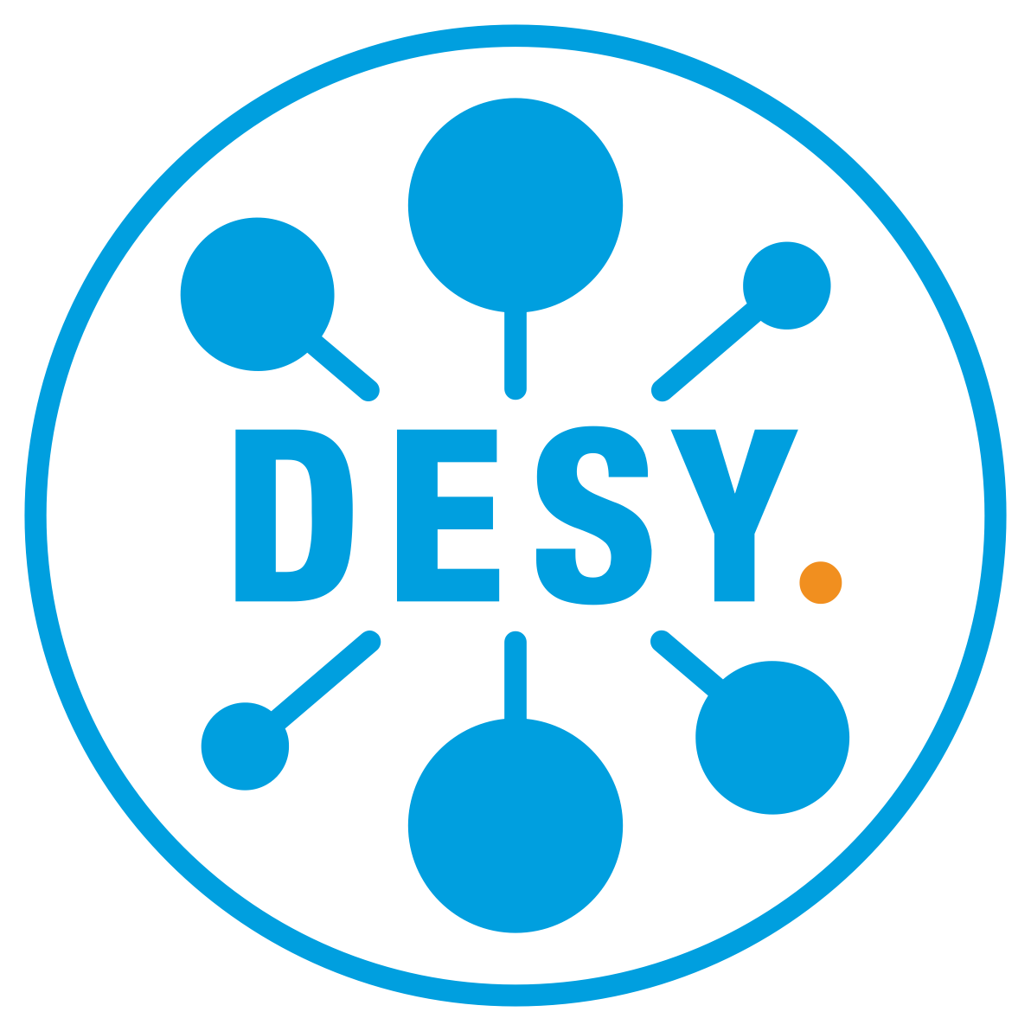


dCache: From Resilience to QoS
Albert L. Rossi (for the dCache collaboration)
Fermi National Accelerator Laboratory
May 18, 2021

Slide 2
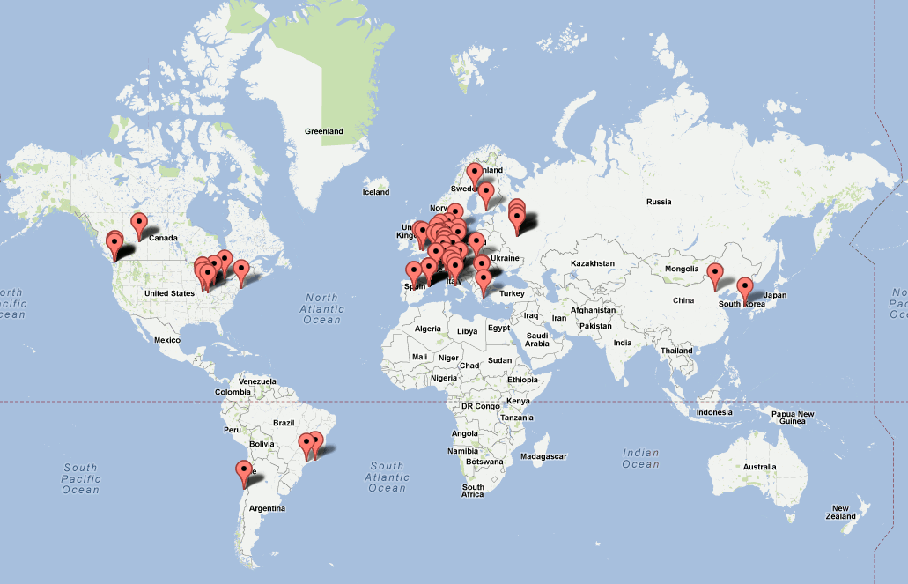
dCache Usage Worldwide
76 installations
accounts for more than 50% of disk space available for LHC
also used by other sciences, including:
astrophysics
neutrino physics
photon science
genomic research
This broad spectrum of users means accommodating different workflows, access, capacity and data preservation requirements, resources and budgets.

Slide 3

dCache Usage: Two Common Scenarios
cached
replica
persistent
replica
Disk cache in front of HSM
(archival storage)
Disk only, with replication
persistent
replica
persistent
replica
permanent
copy

Slide 4
dCache currently provides ability to:
store data to tape and cache a copy on disk;
replicate cached (i.e., temporary) copies of the data if it is being accessed heavily;
"pin" data on disk for a determinate period on behalf of user(s);
restore data from tape to disk;
generate multiple persistent replicas of data on disk;
create new persistent replicas of data if a pool containing a replica goes offline (and remove them when that pool comes back online); this can also involve staging back the data if all such replicas are unavailable and the data is also on tape.
We refer to (5) and (6) as "data resilience".

Slide 5
dCache "Resilience"
dCache subsystem that achieves data durability by maintaining permanent disk replicas independently of the presence of a back-end or tertiary storage system;
relies on a partitioning system into resilient and non-resilient pool groups, with file replication managed only within the former;
seen from the QoS perspective, this also looks like the (static) handling of a subset of QoS classes (in other words, keeping files in certain storage groups on disk for faster access).

Slide 6
Resilience to QoS
The design of Resilience is potentially extensible to other QoS transitions, but the current implementation creates obstacles to this.
Objectives
Transform Resilience into a set of QoS components, retaining all previous Resilience functionality, but no longer requiring the segregation of "resilient" from "non-resilient" data.
Effect a clear separation of layers enabling an API capable of extension without alteration of underlying infrastructure.
Prepare the way for a full-fledged "QoS Engine" in which files can be transitioned between states based on a set of time-bound rules.

Slide 7
Resilience Architecture
Resilience Message Handler
Internal State Maps
Pool Operation
File Update, Operation
Responsible for maintaining the required number of replicas on disk, even when pools go offline or come back online.
Tight integration dictated by this limited purpose, by maximization of efficiency.
Later discovered issues requiring us to break this tight integration.
Those modifications now permit complete separation into independent components.

Slide 8
QoS Equivalents
Receiver: receives messages concerning new files and file QoS changes.
Provider: queried by file and returns the file's requirements.
Verifier: checks the current status of a file and recommends actions, if any.
Adjuster: receives an actionable request for a single operation/transformation (STAGE, FLUSH, COPY, CACHE).
Scanner: receives messages concerning pool status changes and schedules periodic scanning of pools.

Slide 9
QoS Component Interactions
Receiver and Scanner directly converted; other components required pulling apart tightly coupled interactions.
Can be run as separate services or as single standalone service.
Verifier is the heart as in Resilience; Engine is the entry point.

Slide 10
Separation into Components
Allows easier redefinition of the QoS Engine "peripherals":
Adjuster: simple tasks which rely on other parts of dCache to do the heavy lifting; clear separation of concerns will be crucial when optimized restore scheduling is in place. (see Lea Morschel, Improving Performance of Tape Restore Request Scheduling in the Storage System dCache).
Provider: a major motivation for this refactoring; allows for integration with a separate "rule engine".

Slide 11
Rule Engine Prototype
Uses the current combination of namespace attributes (Access Latency and Retention Policy) plus membership in a storage group, which expresses the number and distribution of replicas, to define QoS classes.

Slide 12
Prototype Mapping of dCache Attributes to QoS Classes
ACCESS LATENCY | RETENTION POLICY | storage unit -required | storage unit -onlyOneCopyPer | QOS | Description
NEARLINE | REPLICA | N/A | N/A | volatile | could be removed at any time
NEARLINE | CUSTODIAL | N/A | N/A | tape | on tape; disk copy could be removed at any time
ONLINE | REPLICA | undefined, 1 | N/A | disk | persistent on disk but not written to tape
ONLINE | REPLICA | k > 1 | partitioned by tags | disk | k replicas persistent on disk but not written to tape
ONLINE | CUSTODIAL | undefined, 1 | N/A | disk+tape | persistent on disk and one copy on tape
ONLINE | CUSTODIAL | k > 1 | partitioned by tags | disk+tape | k replicas persistent on disk and one copy on tape

Slide 13
Rule Engine Prototype
On this basis, the following transitions are made available.
Currently can be achieved for single files and for bulk operations, through RESTful API.

Slide 14
Prototype QoS Transitions and How They are Implemented
QOS TRANSITION | CHANGE IN NAMESPACE | WHAT HAPPENS
volatile => disk | NEARLINE REPLICA => ONLINE REPLICA | k replicas are copied or made “sticky”
volatile => tape | NEARLINE REPLICA => NEARLINE CUSTODIAL | file is migrated to tape-backed pool, if necessary, and then flushed
volatile=>disk+tape | NEARLINE REPLICA => ONLINE CUSTODIAL | file is migrated to tape-backed pool, if necessary, and then flushed; k replicas are copied or made “sticky”
disk => tape | ONLINE REPLICA => NEARLINE CUSTODIAL | file is migrated to tape-backed pool, if necessary, and then flushed; all replicas are cached
disk => disk+tape | ONLINE REPLICA => ONLINE CUSTODIAL | file is migrated to tape-backed pool, if necessary, and then flushed
tape => disk | NEARLINE CUSTODIAL => ONLINE REPLICA | NOT SUPPORTED
tape => disk+tape | NEARLINE CUSTODIAL => ONLINE CUSTODIAL | LOCALITY = ONLINE_NEARLINE (file is on disk): k replicas are made sticky or copied if not enough cached replicas already exist
tape => disk+tape | NEARLINE CUSTODIAL => ONLINE CUSTODIAL | LOCALITY = NEARLINE (file not currently on disk): file is staged from tape; k replicas are copied
disk+tape => tape | ONLINE CUSTODIAL => NEARLINE CUSTODIAL | all replicas are cached
disk+tape => disk | ONLINE CUSTODIAL => ONLINE REPLICA | NOT SUPPORTED

Slide 15
Rule Engine Prototype Limitations
Only the namespace attributes can be changed dynamically for single files (via a query); the number of copies is statically defined by storage unit.
No provision for indicating the number or distribution of copies that should reside on tertiary storage.
No component which could be given time-based rules concerning how and when an individual file’s QoS should be changed.
Overcoming the coarseness of these semantics will be a major goal for future dCache QoS development.

Slide 16
Acknowledgments
This work is supported by the Fermi National Accelerator Laboratory, managed and operated by Fermi Research Alliance, LLC under Contract No. DE-AC02-07CH11359 with the U.S. Department of Energy. The U.S. Government retains and the publisher, by accepting the article for publication, acknowledges that the U.S. Government retains a non-exclusive, paid-up, irrevocable, world-wide license to publish or reproduce the published form of this manuscript, or allow others to do so, for U.S. Government purposes.

Slide 17
Thank you for listening. Questions?

Slide 18
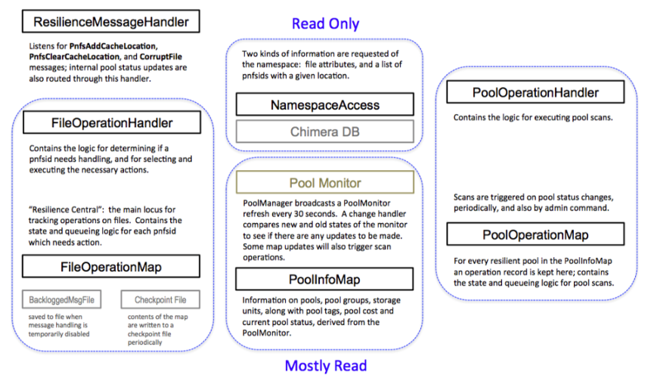
Resilience Component Responsibilities
process incoming updates from namespace
store data about state
1. how many replicas are
required?
intercept pool status changes
schedule periodic scans
(2) + Pools
(1)
(4)
2. how many replicas are currently accessible?
(1)
(4)
(3) + Pools
3. make the necessary adjustments
(3)
(2)
(1)
(4)
4. react to a change in pool state or periodically
verify for consistency

Slide 19
QoS Request Handling (Messaging)
Receive message (cache update or QoS modification).
Check the file requirements.
Request verification.
Verify the status of the file (how many replicas, on tape, etc.) on the pools (and recontact provider on iteration).
Determine action and possibly request adjustment.
Process the task; if it fails, possibly retry.
Notify verifier of success/failure; verifier reevaluates for further action (retry, continue to new action, quit).
Remove operation and send verification/action completed message.
Notify QoS transition completed (topic).
A - the current rule engine uses the namespace and Pool Selection Unit. B - The pool selection is done by the verifier and sent as part of the message to the adjuster; verifier keeps track of maximum running slots and only sends ready tasks to the adjuster. C - The adjuster queues the requests, maps them to adjuster types and executes; the types call out to either the pools or the PinManager.

Slide 20
dCache Mission Statement
“... to provide a system for storing and retrieving huge amounts of data, distributed among a large number of heterogeneous server nodes, under a single virtual filesystem tree with a variety of standard access methods.”
https://www.dcache.org/about

Slide 21
"Quality of Service" and dCache
There can be a considerable difference in the scientists’ desires and expectations about how this data is stored and made available for analysis:
durability (likelihood of data loss);
total bandwidth (aggregated over all clients);
bandwidth available to a single client;
access latency;
some combination of these factors.
Can be based on:
intrinsic properties of the data;
types of activity using the data.

Slide 22
"Quality of Service" and dCache
Not practical or necessary to expose all combinations of options.
Need to organize these into a common set of agreed-upon QoS classes.
By allowing scientists to choose and modify with which QoS class they would like their data stored, a storage system gives scientists the ability to achieve the optimal storage strategy within the available storage capacity.
The following is part of an ongoing effort to enhance dCache's capacity to respond to the QoS needs of the communities which deploy it.

Slide 23
dCache in one slide
JVM
JVM
JVM
Message passing layer
Pool
Manager
Namespace
Pools
(Data Server)
Pools
Door
Pools
(Data Server)
Door
http
DBMS
dcap
nfs
ftp
xroot

